Slide 1
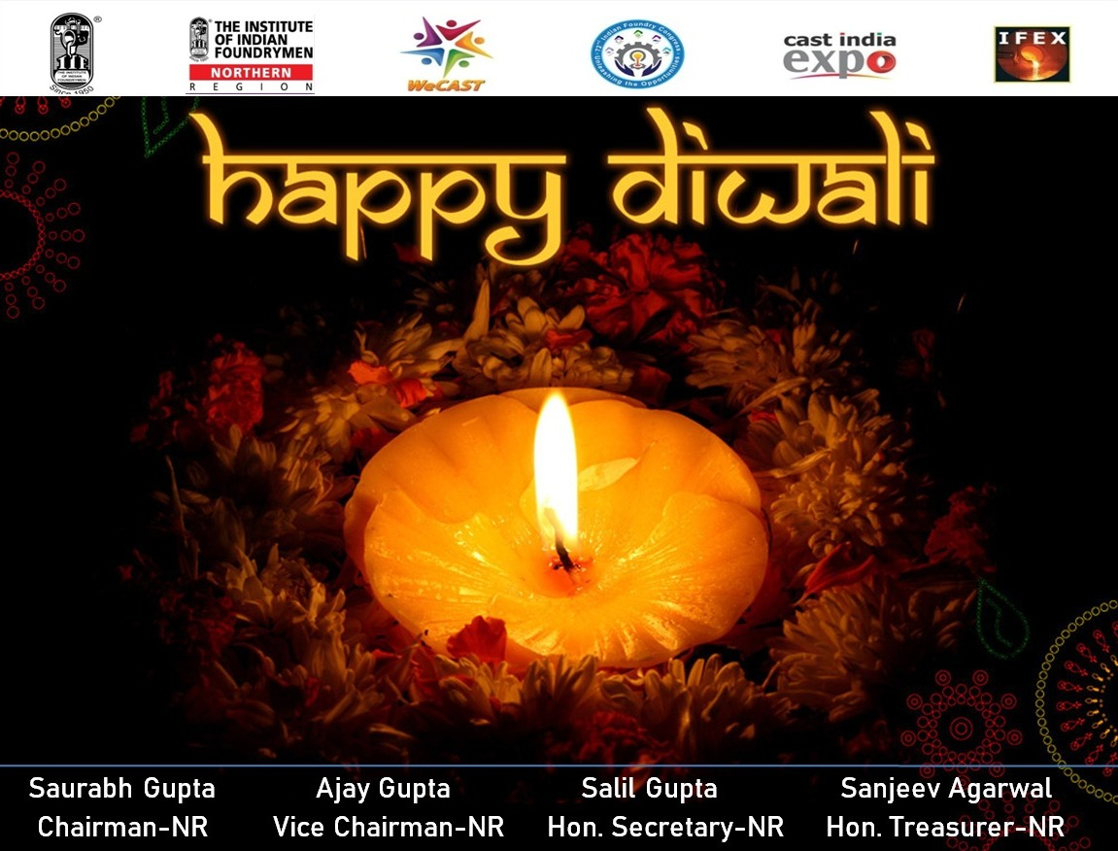

ACTIVITY REPORT IIF
DELHI CHAPTER
Year: 2023-24

Slide 2
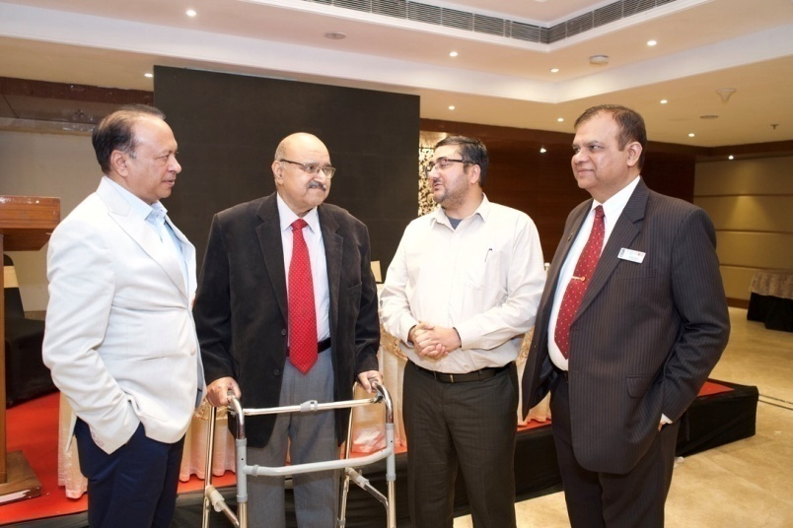
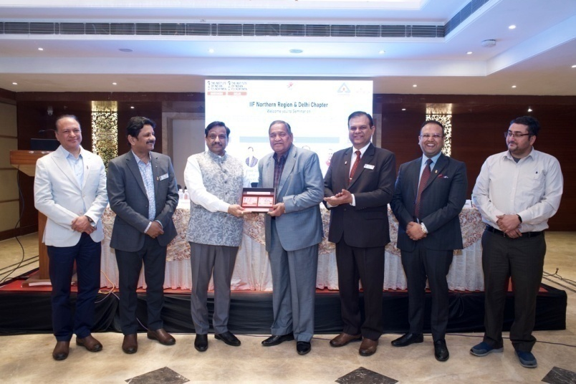
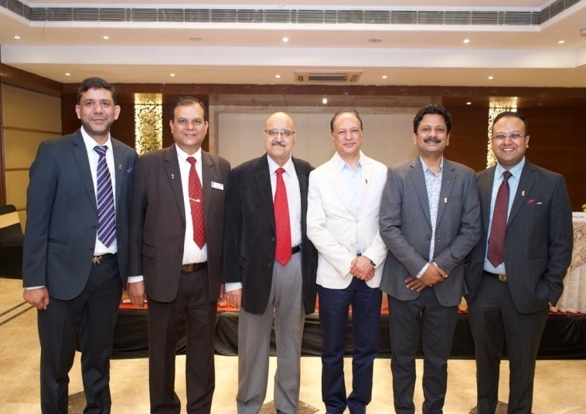
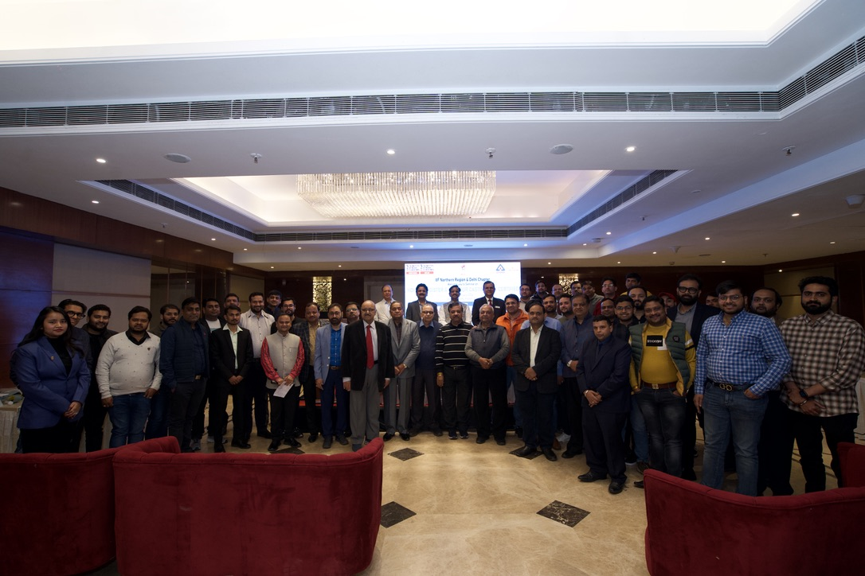
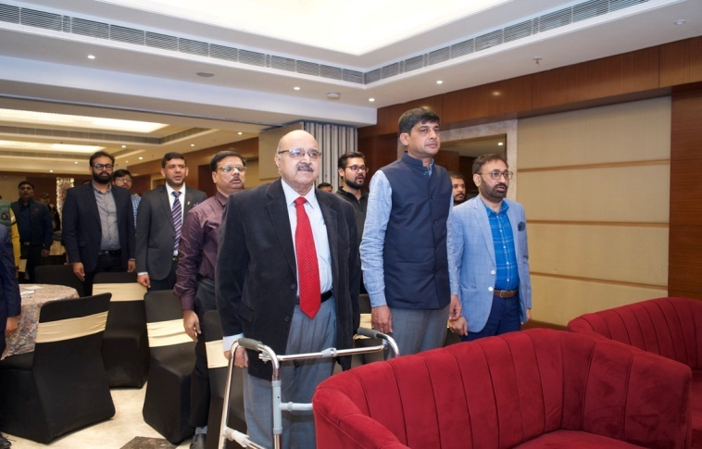
Awareness Seminar at Agra
IIF Northern Region and IIF Delhi Chapter jointly with BIS Govt of India organized a seminar on “How to register and get your castings BIS certified ” on 22nd February 2024 at the PL Palace Hotel, Agra

Slide 3
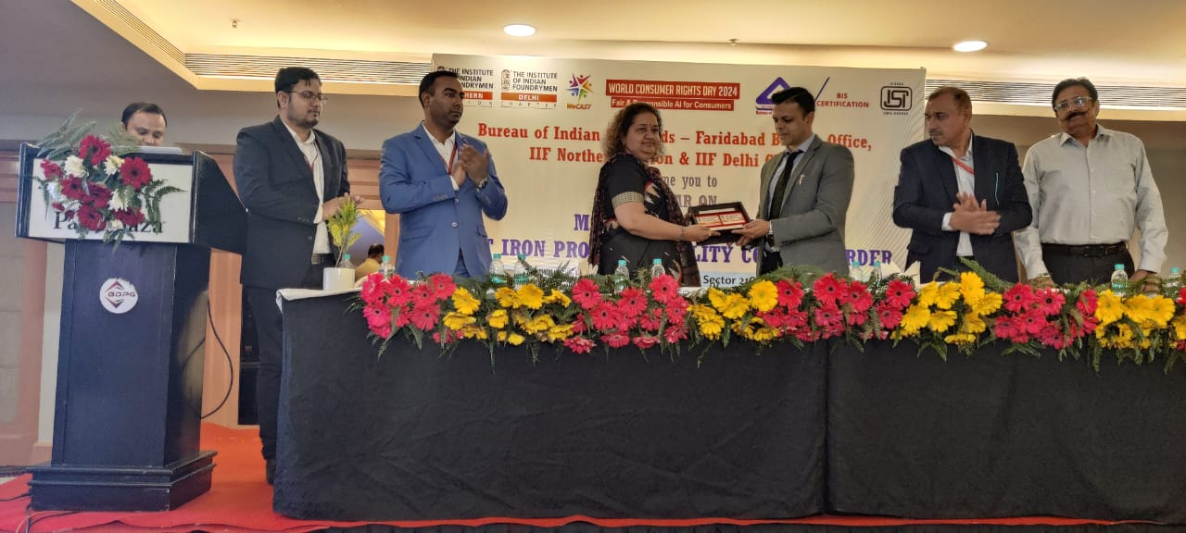
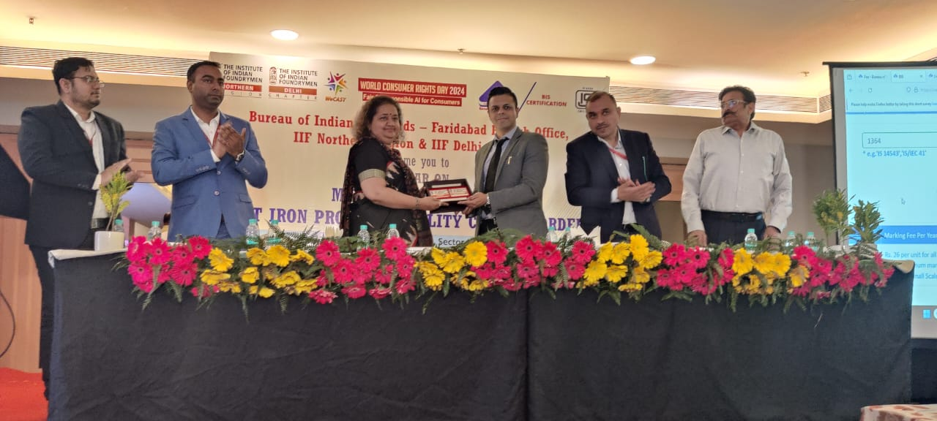
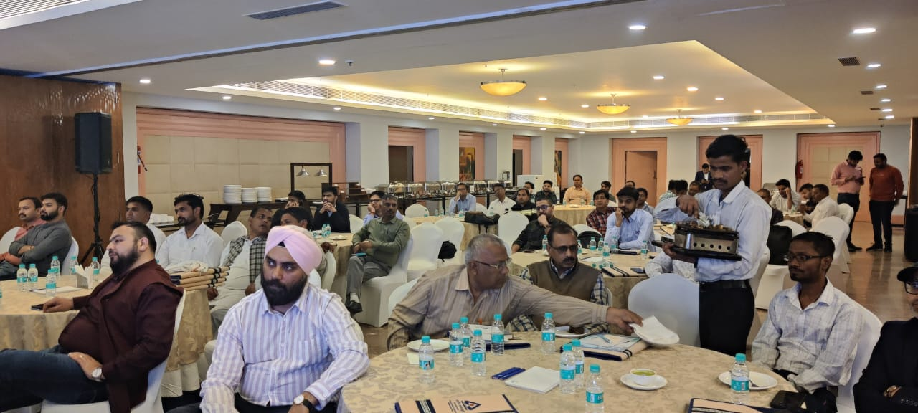
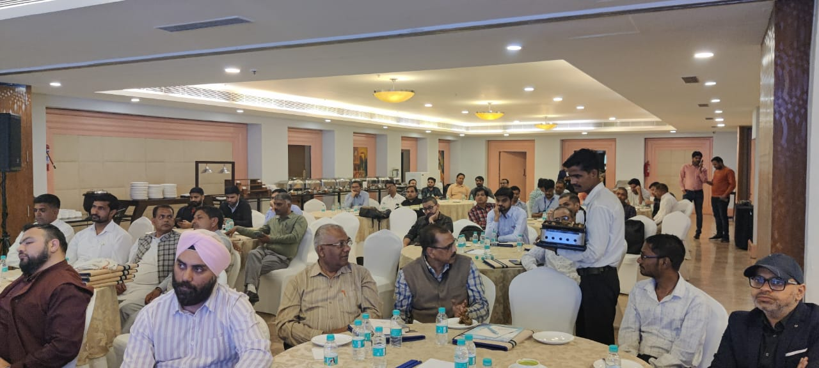
Awareness Seminar at Faridabad
To commemorate the World Consumers Right Day , IIF Northern Region and IIF Delhi Chapter jointly with BIS organized a seminar on “How to register and get your castings BIS certified ” on 15th March 2024 at Faridabad.
Ms. Vibha Rani, Director and Head and Mr. Rahul, Jt. Director, BIS were the key speakers. Mr. Salil Gupta, Hon Secretary, IIF NR and Mr. Ashok Sharma, Chairman, IIF Delhi Chapter along with our members joined the seminar.

Slide 4
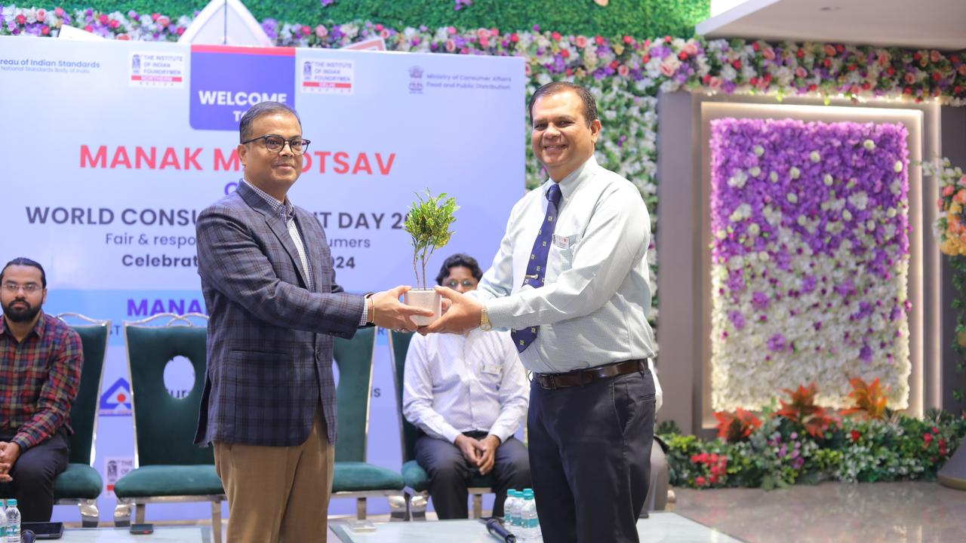
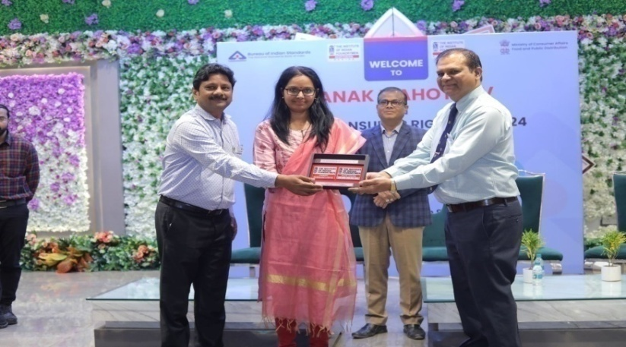
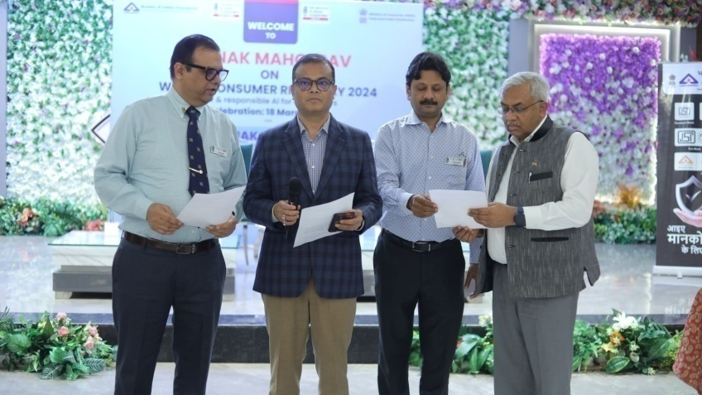
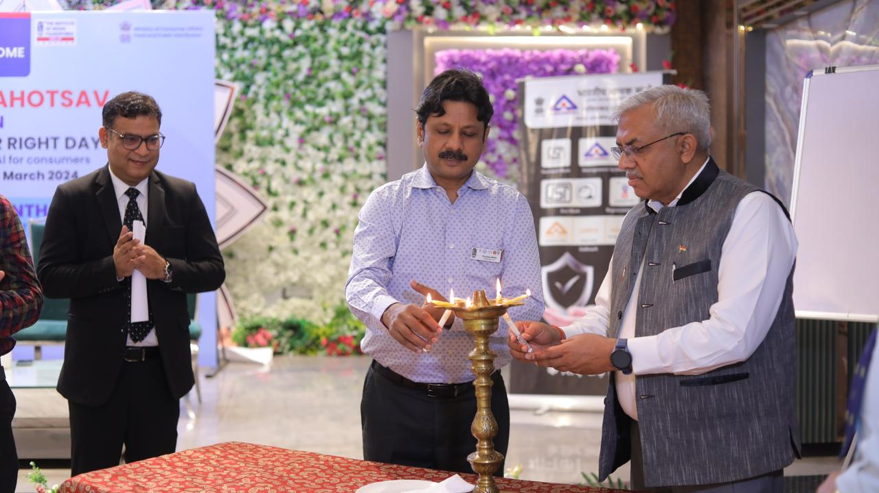
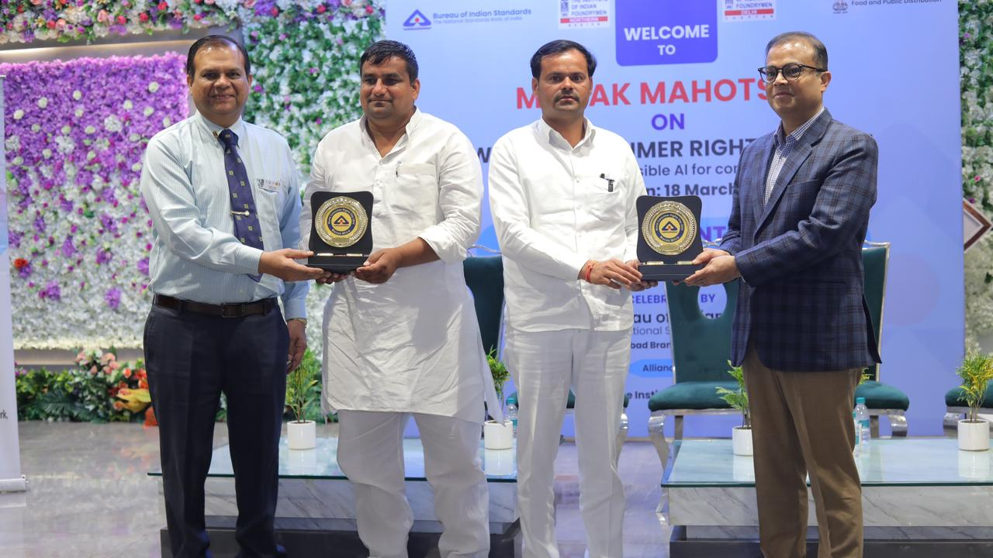
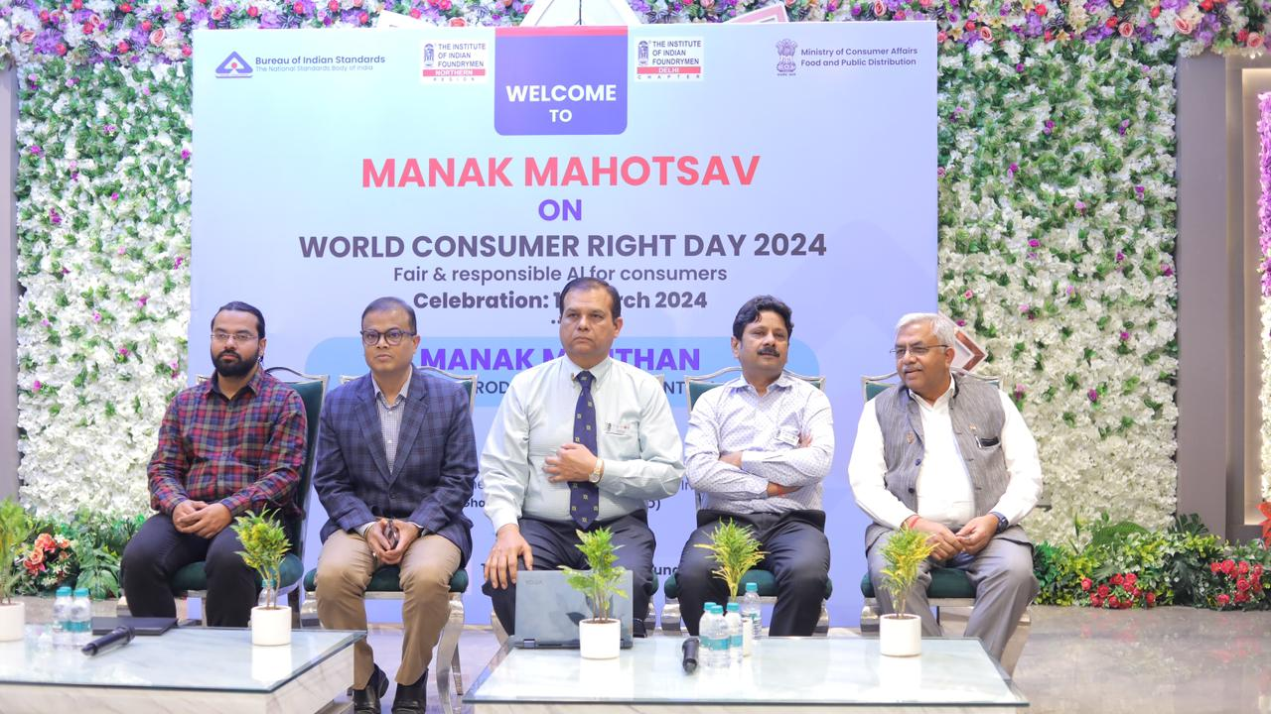
Awareness Seminar at Ghaziabad
IF Northern Region and IIF Delhi Chapter jointly with BIS celebrated ”Manak Manthan day” on 18th March 2024 at Ghaziabad.
Head BIS Ghaziabad was the key speaker in the Seminar. IIF participated in the Award process of BIS for creating awareness on Standards as JURY members.

Slide 5
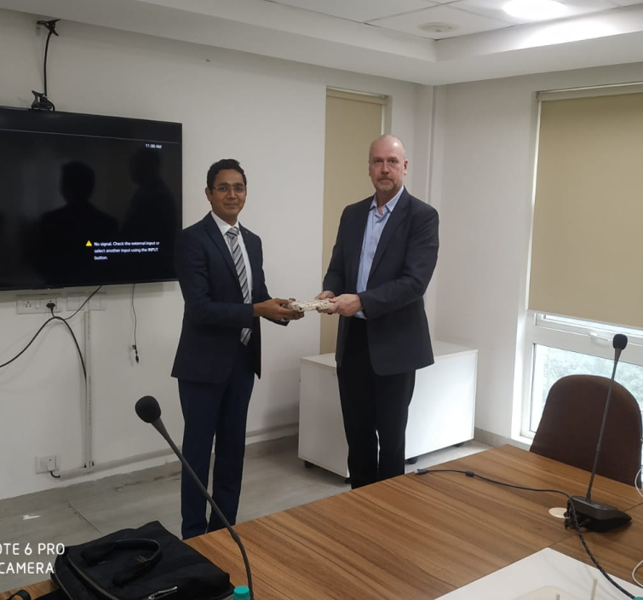
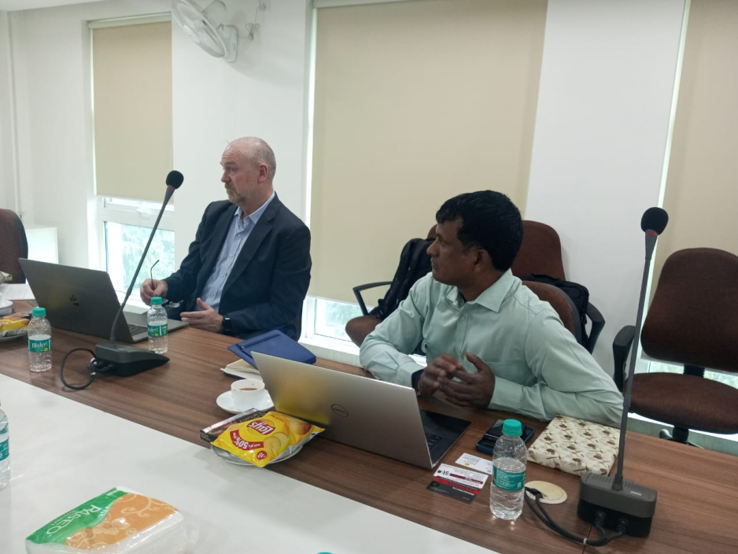
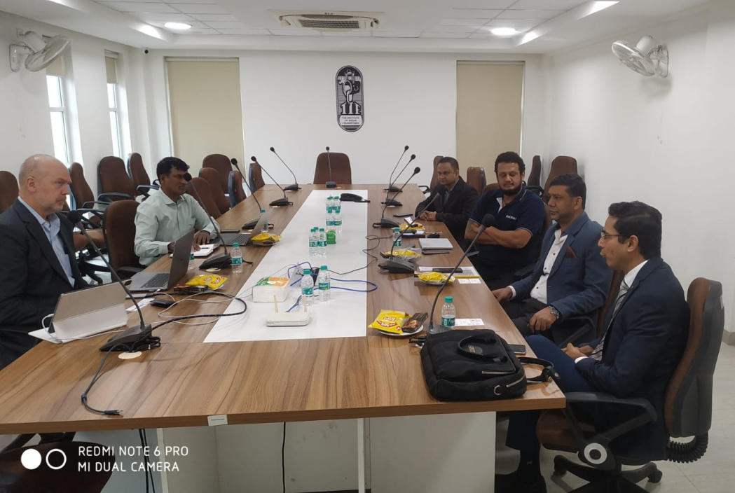
B2B Meetings
IIF Northern Region jointly with its Delhi chapter has organized a B2B Meet with a US based Casting buyer (NORCA) in its office located in New Delhi on 13th February 2024.
The meeting was organized in continuation to the dialogue initiated by the FIC with the company at IFEX 2024, recently concluded at Bengaluru on 4th February 2024. The objective of arranging the meeting was to provide an opportunity to our members to explore international market & business growth.
IIF Members from Shivamoga, Punjab, Agra & Delhi NCR participated in the meeting.

